Slide 1
Build Microsoft Teams customization using SharePoint Framework
Overview
Notes:
Recorded session of this lesson available at:
https://www.youtube.com/watch?v=Yfs3-qawJfA

Slide 2

Overview
Understanding Microsoft Teams Development
Benefits to using SharePoint Framework to Extend Microsoft Teams
Surfacing SharePoint Framework Customizations in Microsoft Teams

Slide 3
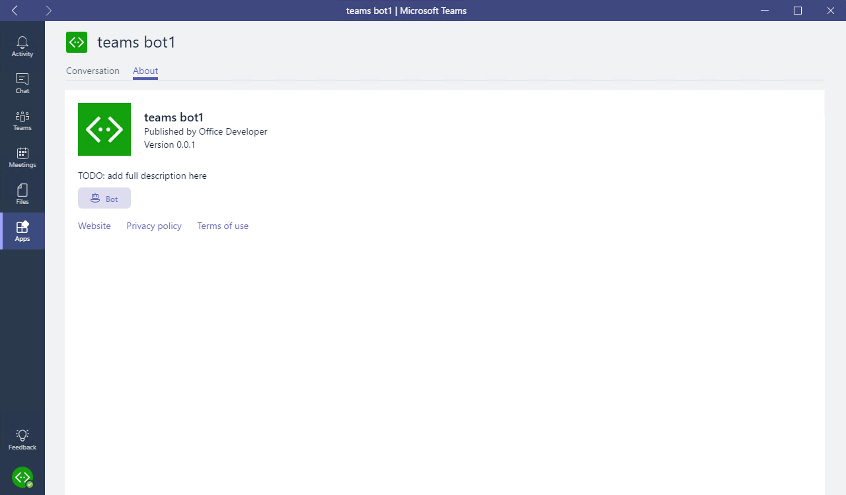
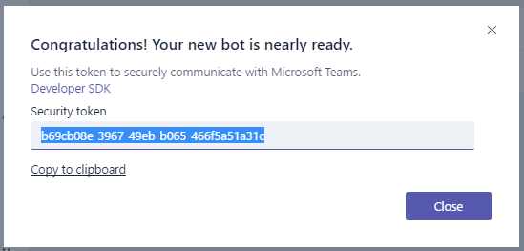
Microsoft Teams-extensibility options
Microsoft Teams App
Tabs
Bots
Messaging extensions
Connectors
Custom Bot
Receive & reply to messages

Slide 4
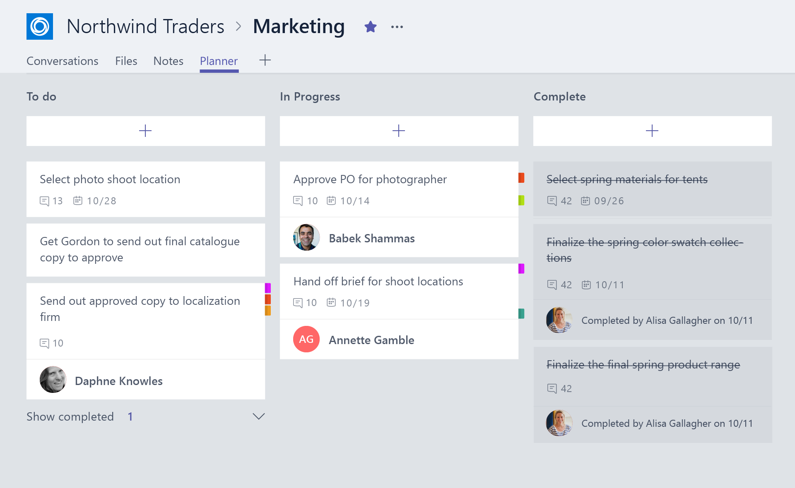
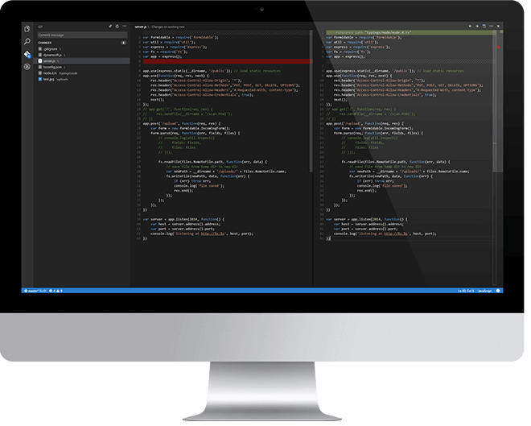
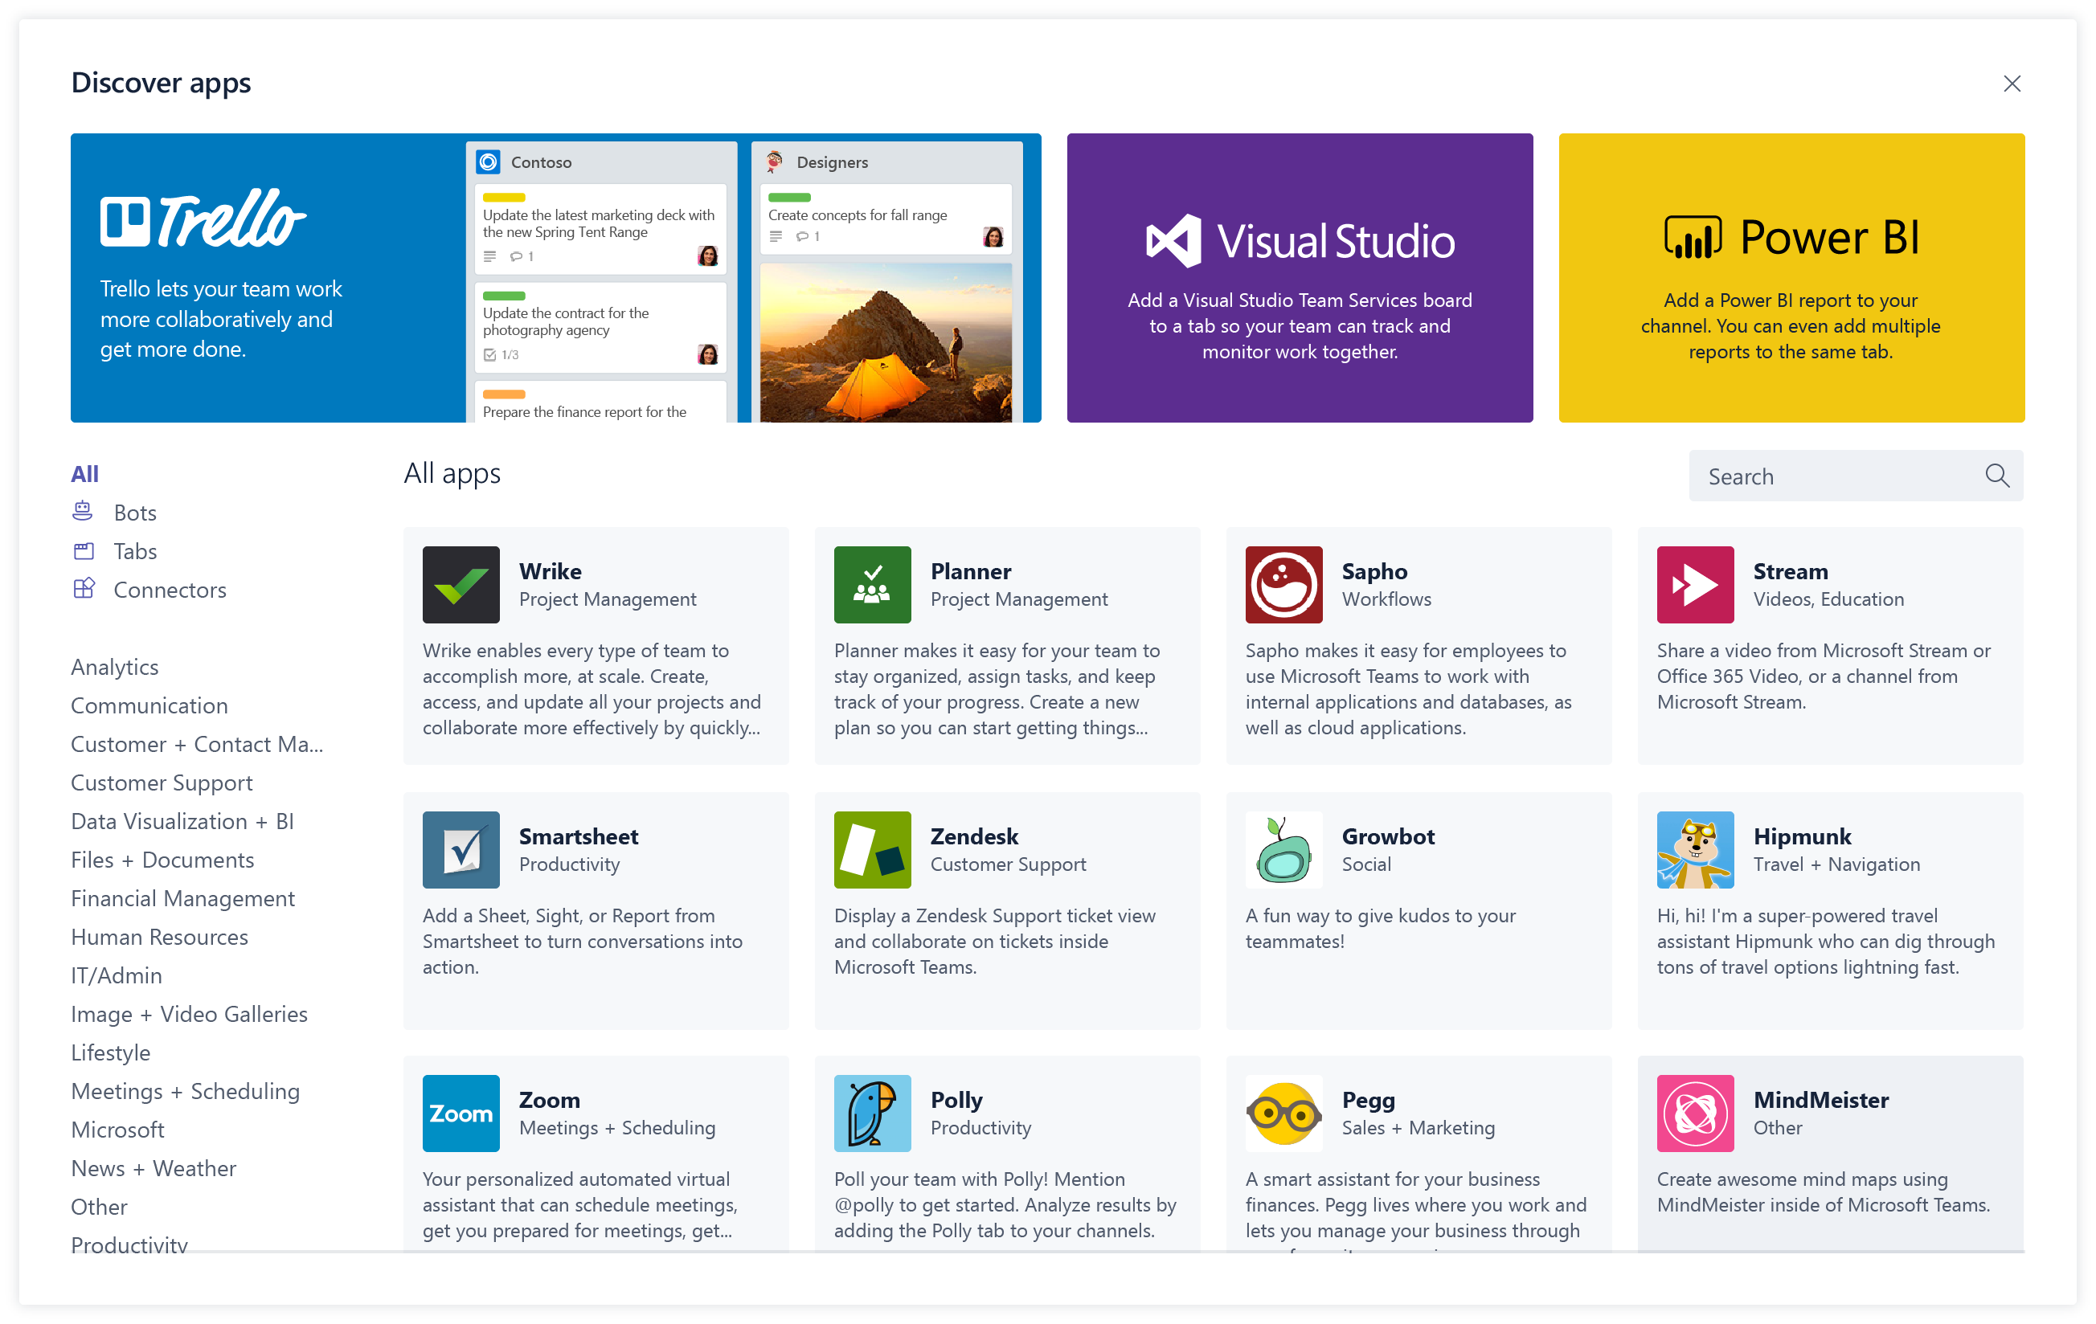
Overview of building a Microsoft Teams Tab
Design a great tab
Select relevant app functionality
Scope and focus the user experience
Integrate and streamline access
Develop your tab
HTML/JavaScript/TypeScript
REST services
Deep Linking and context
Deploy your tab
Upload to Team
Upload to Tenant App Gallery
Submit to Office Store
Notes:
Design
Focused functionality
Tabs work best when they’re built to address a specific need. Focus on a small set of tasks or a subset of data that’s relevant to the channel the tab is in.
Reduced chrome
Avoid creating multiple panels in a tab, adding layers of navigation, or requiring users to scroll both vertically and horizontally in one tab. In other words, try not to have tabs in your tab.
Integration
Find ways to notify users about tab activity by posting cards to a conversation, for example.
Conversational
Find a way to facilitate conversation around a tab. This ensures that conversations center on the content, data, or process at hand.
Streamlined access
Make sure you’re granting access to the right people at the right time. Keeping your sign-in process simple will avoid creating barriers to contribution and collaboration.
Develop
Any editor
Call any service
Deploy
Seller Dashboard is used to submit to store
Not necessary for tabs – can upload

Slide 5
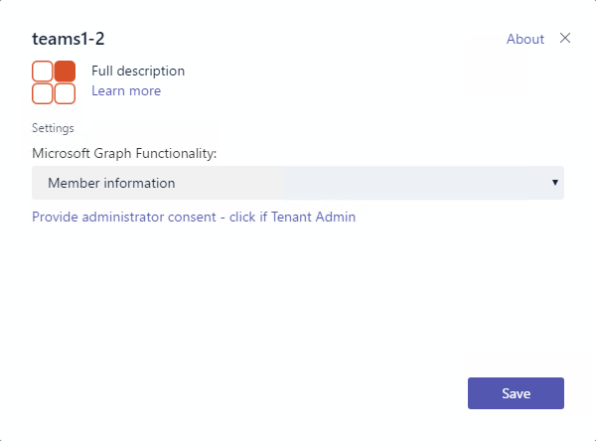
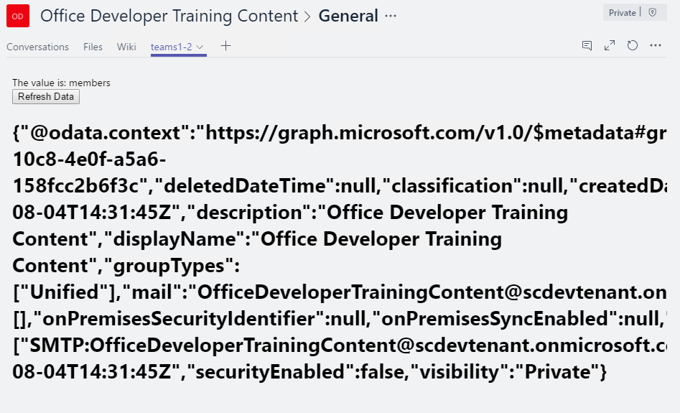
Tab Configuration and Content
Tab Configuration
Configured in manifest
Displayed when Tab added to Channel
Collect information
Tab Content
Rendered in IFRAME
Url specified by configuration page
Inspect context for EntityId/SubEntityId
Retrieve state based on Entity/SubEntity/User
Notes:
To provide a seamless tab experience, perform provisioning and authorization on configuration page when possible.
If context has entity/subentity, then respond to a deeplink
State storage is developer’s responsibility

Slide 6
Interacting with Microsoft Teams
Teams API provides context for User / Team / Organization
Getting Context through URL placeholders
Placeholders specified in URL in manifest
Resolved at runtime
Placeholders for each property of Context object
{upn}, {teamId}
Getting Context through the JavaScript library
Library provides function to get context
microsoftTeams.getContext()
Asynchronous method with only success callback
Returns context object
Noteworth Properties | Description
teamId | The team ID in the format 19:[id]@thread.skype
channelId | The channel ID in the format 19:[id]@thread.skype
Locale | Lowercase lang-locale
theme | default | dark | contrast
entityId | The entity id you set up on your config page
subEntityId | The sub entity id you set up on your config page
upn | The user identifier in email format
tid | Guid identifying the current Tenant ID
groupId | Guid identifying the current O365 Group ID

Slide 7
Deploy SharePoint Framework Web Parts as Microsoft Teams Tabs!

Slide 8
Benefits to using SharePoint Framework to Extend Microsoft Teams
Development model is similar to SharePoint Framework web parts
Any web part can be exposed as a tab in Microsoft Teams
Have difference scoping options on exposing your custom tab as a web part and tab in your tenant
Tab executed in the context of the underlaying SharePoint site behind of the specific team
Take advantage of any SharePoint specific APIs or functionalities in your web part!
Access SharePoint REST API, Microsoft Graph, Azure AD-secured Endpoints… all straight from the SPFx API

Slide 9
How to Surface SharePoint Framework Web Parts as Microsoft Teams Tabs?
Specify web part can be a tab
Create Microsoft Teams tab images & descriptions
Create manifest to Microsoft Teams app

Slide 10
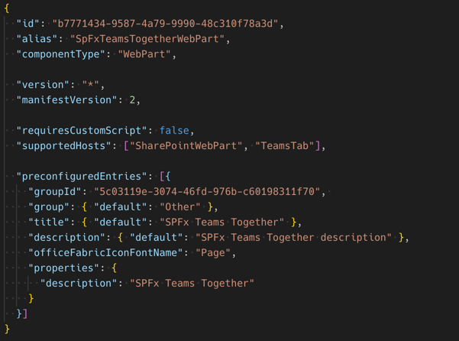
Specify SharePoint Framework Web Part can be Microsoft Teams Tab
Web part manifest property: supportedHosts
Web parts in SharePoint: SharePointWebPart
Tabs in Microsoft Teams: TeamsTab

Slide 11
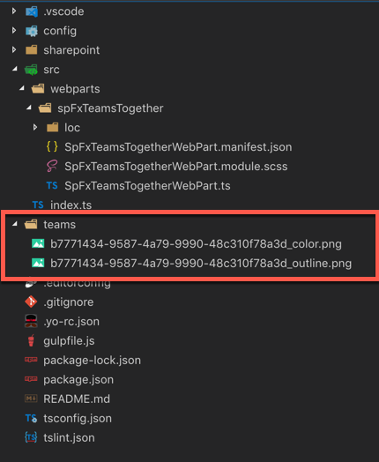

Create Microsoft Teams Tab Images
Default Microsoft Teams tab icon

Slide 12
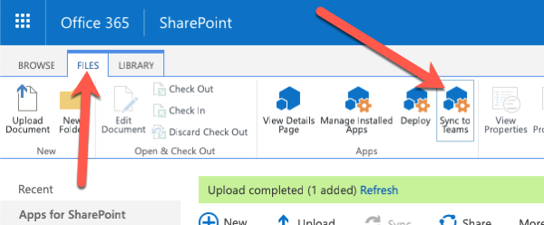
Create Microsoft Teams App manifest
Tells Microsoft Teams about the app:
Name and location of images
Name and description of application
”About” and metadata for application
Location of underlying application
SharePoint Framework web parts as Teams Tabs – already have most of the information in the SharePoint component’s manifest
SharePoint creates & deploys Microsoft Teams manifest automatically
Manual process performed by within SharePoint’s App Catalog
Dynamically creates the Microsoft Teams app manifest
Zips up manifest + images
Deploys to Microsoft Teams store

Slide 13
Demo Extending Microsoft Teams with SharePoint Framework Web Parts
Notes:
Demo steps:
https://github.com/SharePoint/sp-dev-training-spfx-teams-dev/tree/master/Demos/01-spfxteams

Slide 14

Summary
Understanding Microsoft Teams Development
Benefits to using SharePoint Framework to Extend Microsoft Teams
Surfacing SharePoint Framework Customizations in Microsoft Teams

Slide 15
Build Microsoft Teams customization using SharePoint Framework
Leveraging SharePoint & Microsoft Teams Contexts

Slide 16
Overview
Understand SPFx-Based Microsoft Teams Tabs
SharePoint Context
Microsoft Teams Context

Slide 17
SharePoint Framework & Microsoft Teams Context
SharePoint Framework Web Parts have access to the current page context
Provide access to the current page, site and site collection
SharePoint Framework v1.8.0 introduced the Microsoft Teams context object
Same Microsoft Teams context object available from the Microsoft Teams JavaScript SDK
NPM Package: @microsoft/teams-js
Use the presence of the Microsoft Teams context to determine if web part is running in SharePoint or Microsoft Teams

Slide 18
Working with the Microsoft Teams Context
private teamsContext: microsoftTeams.Context;
...
protected onInit(): Promise<void> {
return new Promise<void>((resolve, reject) => {
if (this.context.microsoftTeams) {
this.context.microsoftTeams.getContext(context => {
this.teamsContext = context;
resolve();
});
} else {
resolve();
}
});
}
...
let title: string = (this.teamsContext) ? 'Teams' : 'SharePoint’;
let currentLocation: string = (this.teamsContext)
? `Team: ${ this.teamsContext.teamName }` : `site collection ${ this.context.pageContext.web.title }`;

Slide 19
Demo Working with SharePoint & Microsoft Teams Contexts
Notes:
Demo steps:
https://github.com/SharePoint/sp-dev-training-spfx-teams-dev/tree/master/Demos/02-spfxteams

Slide 20
Summary
Understand SPFx-Based Microsoft Teams Tabs
SharePoint Context
Microsoft Teams Context

Slide 21
Build Microsoft Teams customization using SharePoint Framework
Configuration

Slide 22
Overview
Custom Microsoft Teams Tab Configuration Options
Configure Once at Install
Edit Configuration in the Future

Slide 23
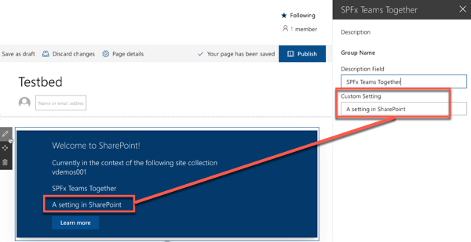
Custom Microsoft Teams Tab Configuration Options
SharePoint Framework web parts have public properties
Public properties can be made editable via the property pane
SharePoint page must be in edit mode to edit properties
User must have edit rights to the page to access the property pane

Slide 24
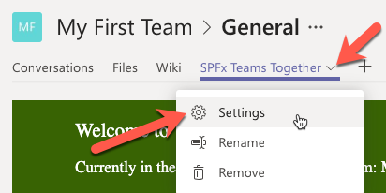
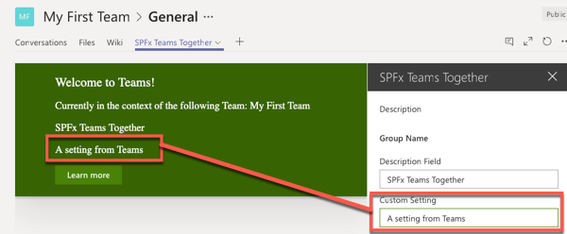
Property Pane Exposed in Microsoft Teams
Web Part property pane displayed when SPFx web part installed as a tab in a Microsoft Teams team
Accessible via the tab context menu Settings option

Slide 25
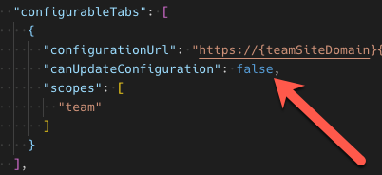
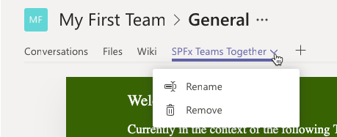
Configure Settings – Edit Only on Install
Developers optionally set property in Microsoft Teams app manifest to only allow SPFx web part properties to be set when tabs installed

Slide 26
Demo Configuring SPFx Web Parts as Microsoft Teams tabs
Notes:
Demo steps:
https://github.com/SharePoint/sp-dev-training-spfx-teams-dev/tree/master/Demos/03-spfxteams

Slide 27
Summary
Custom Microsoft Teams Tab Configuration Options
Configure Once at Install
Edit Configuration in the Future

Slide 28
Reading further
SharePoint Framework
https://docs.microsoft.com/sharepoint/dev/spfx/sharepoint-framework-overview
Building Microsoft Teams Tabs using SharePoint Framework
https://docs.microsoft.com/sharepoint/dev/spfx/integrate-with-teams-introduction

Slide 29
Lab In this lab you will create a SharePoint Framework (SPFx) solution that will work in both SharePoint and Microsoft Teams. aka.ms/spdevwsM4L9
Notes:
Lab manual at:
https://aka.ms/spdevwsm4l9

